Slide 1
EU instruments to support the Bologna Process
Kamila Partyka
Directorate-General
for Education and Culture
European Commission

Slide 2
Bologna Process
Since 1999
Currently 48 countries
Dialogue, shared goals, common commitments
Voluntary convergence and coordinated reforms of higher education systems
Impetus for other regional higher education cooperation efforts

Slide 3
Yerevan Communiqué (2015)
Four priorities:
Enhancing the quality and relevance of learning and teaching
Fostering the employability of graduates throughout their working life
Making systems more inclusive
Implementing agreed structural reforms

Slide 4
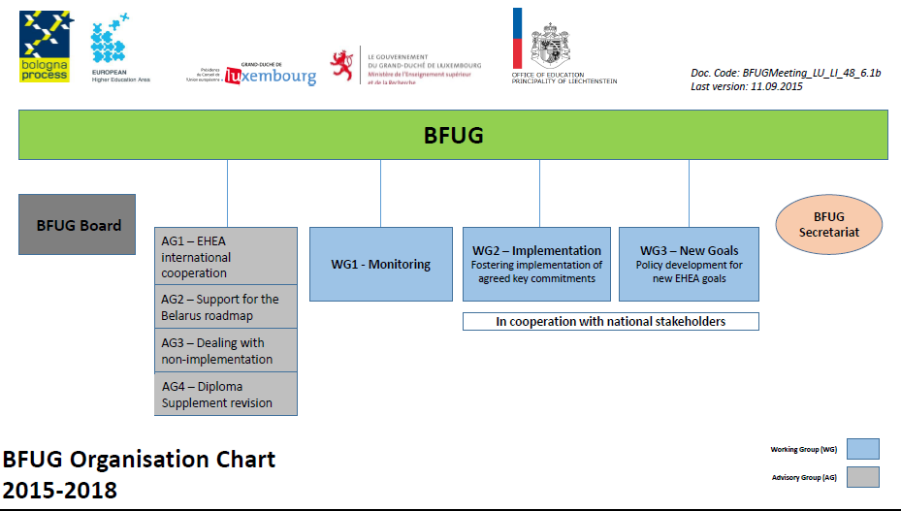
Work plan 2015-2018

Slide 5
EU role in supporting HE reforms
Open Method of Coordination
Strategic Framework: Education and Training (ET) 2020
Commission Communications and Recommendations
Taking forward special initiatives (recognition, quality assurance, ECTS, EQF, EAR Manual)
EU programmes

Slide 6
H2020 Marie Skłodowska-Curie actions
Doctoral training
Excellence
Research training
Innovation
Entrepreneurship
A new generation of researchers
Mobility and careers
Doctoral programmes: industrial, joint, double
IDTP principles
2014-2020 budget: EUR 6.2 billion

Slide 7
Erasmus+
Learning mobility of individuals (lecturers, teachers, trainers, education staff and youth workers)
1
Mobility
2
Cooperation
Cooperation for innovation
Strategic Partnerships
Knowledge Alliances and Sector Skills Alliances
Jean Monnet
Sport
3
Policy Support
Support for policy reforms and dialogue with stakeholders
2014-2020, EUR 14.7 billion

Slide 8
International HE cooperation
Academic
mobility
Jean Monnet Activities
Capacity Building for HE
Degree mobility
EMJMD
International credit mobility
Academic cooperation

Slide 9
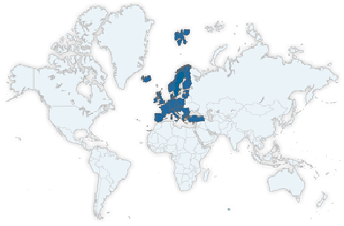
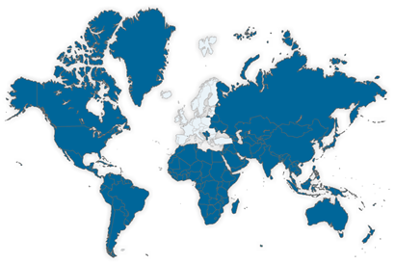
Participants
Programme countries
28 EU countries, Iceland, Liechtenstein, FYROM, Norway, Turkey
Partner countries
All other countries in the world

Slide 10


135,000 student & staff exchanges with Partner countries over 7 years
Joint Master degrees: 30,000 students worldwide
1000 Capacity Building Projects with 150 Partner countries over 7 years

Slide 11
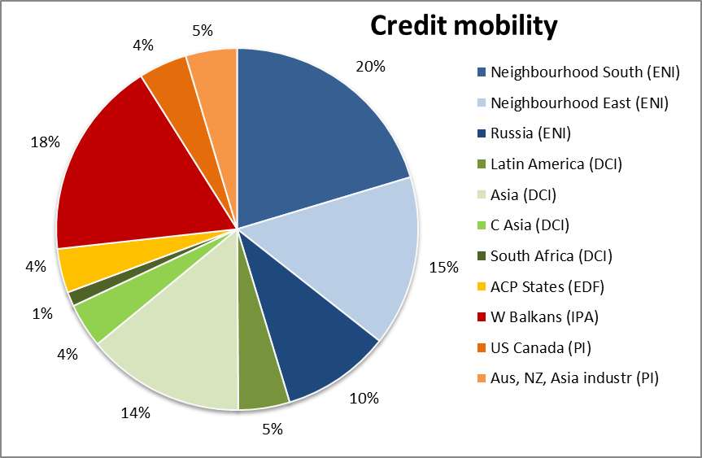
Credit mobility per region

Slide 12
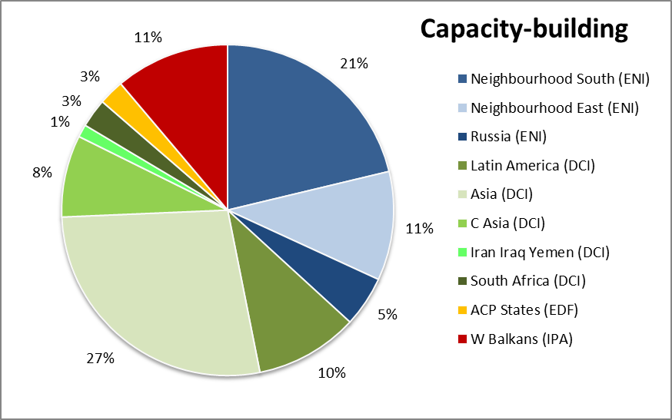
CBHE and development

Slide 13
ECTS for student-centred teaching and learning
Tool for transparency, recognition and quality
Student needs at the centre of programme design, admission procedures and recognition
Enhanced student autonomy, responsibility and critical abilities through an outcome-based approach
Tailor-made, flexible learning pathways
The revised ECTS Users' Guide (2015)

Slide 14
Recognition
Increasing students' study choices
The Pathfinder Group report on Automatic Recognition (Dec 2014):
  Automatic recognition at system level the most promising path to follow
  Qualification following EHEA 3-cycle structure from one EHEA country should be recognised anywhere else in the EHEA

Slide 15
Higher Education Reform Experts
Financed through the Erasmus+ programme
Pool of experts supporting the modernisation of higher education
Countries neighbouring the EU
Activities: seminars, articles and reports, advice to individual institutions and policy makers
Around 250 experts, managed at the local level by the National Erasmus+ Offices, in cooperation with the relevant national authorities

Slide 16
Dedicated support for EHEA reforms
Erasmus+ restricted call (programme countries)
Current projects running until October 2016
New projects – deadline 17 February 2016
Support to implementation of European tools, quality assurance, recognition, mobility and internationalisation
Support the shift to student-centred learning

Slide 17
Support to Belarus roadmap of reforms
HERE events and technical assistance missions
Capacity building projects (currently 4 involve BY)
Credit mobility (2015: 260 student and staff member from BY)
Degree mobility (no institution involved, 5 scholarships)
Researcher mobility and training (8 projects on exchanges + 1 associated partner in doctoral programme)
Jean Monnet (4 activities selected)
Eastern Partnership Platform 4 activities
TAIEX (expert missions, workshops)

Slide 18

Information on Erasmus+
http://ec.europa.eu/programmes/erasmus-plus/index_en.htm
Information on Erasmus+ funding opportunities
http://eacea.ec.europa.eu/erasmus-plus/funding_en
Information on MSCA
http://ec.europa.eu/msca

